Slide 1
AsyncSC: An Asynchronous Sidechain for
Multi-Domain Data Exchange in Internet of Things
¹Lingxiao Yang, ¹Xuewen Dong, ²Zhiguo Wan, ³Sheng Gao,
⁴Wei Tong, ¹Di Lu, ¹Yulong Shen, ⁵Xiaojiang Du
¹Xidian University
²Zhejiang Lab
³Central University of Finance and Economics
⁴Zhejiang Sci-Tech University
⁵Stevens Institute of Technology
Presentation for INFOCOM 2025
Notes:
Good afternoon, everyone. It’s a great honor to be here today to present our work in Infocom 2025.
My name is LingXiao, and I am from Xidian University. The title of our paper Is:
Actually，this work belongs to the blockchain area， even this session is about market and insensitive。Anyway， let start my presentation

Slide 2
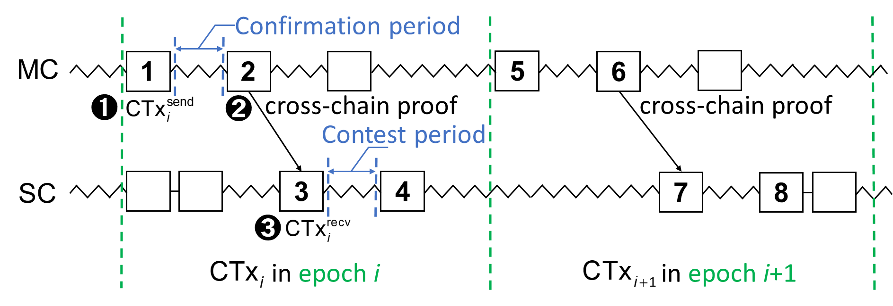





















Introduction
Cross-chain techniques
Sidechain techniques
Two Main Challenges in Sidechains
Challenges:
Synchronous status
1.High communication load
Cosmos
Relay chain
Internet of Things
NFT Market
Cryptocurrency
2. Low cross-chain efficiency
Transactions are executed sequentially
Notes:
I am pleased to introduce the background of this work. First, it belongs to the Cross-chain techniques
As we can see from the pictures below, the mainstream cross-chain projects include:
And the cross-chain techniques have been applied in many scenarios，such as。。。
In this work，we take the IoT as an example. As we known，IoT devices maybe resource constrained with unstable network connections. So, we conduct the research in asynchronous environment
切 By the way, Its worth note that these cross-chain projects are relied on the Relay chain -> trusted third party. There are potential security issues，such as single point of failure risks
切 Sidechain -> relay-free
Traditional cross-chain proof is the spv proof，which is generated by the spv node，and is formed with full blockchain‘s block heads
切 in a short，this figure shows the sidechain-based cross-chain process。MC（source chain），SC（target chain）

Slide 3
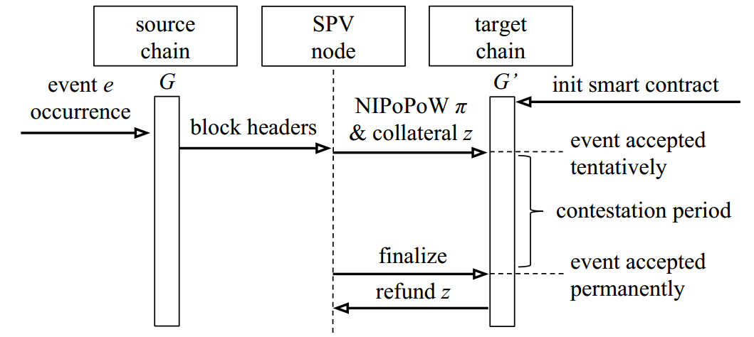
Introduction
PoW sidechains [1]: Proof-of-work sidechains
“efficient SPV proofs”
Superblocks
Interlink
[1] A. Kiayias and D. Zindros, “Proof-of-work sidechains,” in International Conference on Financial Cryptography and Data Security (FC). Springer, 2019, pp. 21–34.
Notes:
Before diving into the specifics of our approach, let’s first introduce some related works
​Non-Interactive Proofs of Proof-of-Work -> efficient SPV proofs
It uses blocks with high mining difficulty as superblocks to form an index（Interlink）. NIPoPoWs can provide proof of effectiveness of on-chain events without downloading the complete blockchain
The size of the cross-chain proof is related to the length of the blockchain

Slide 4
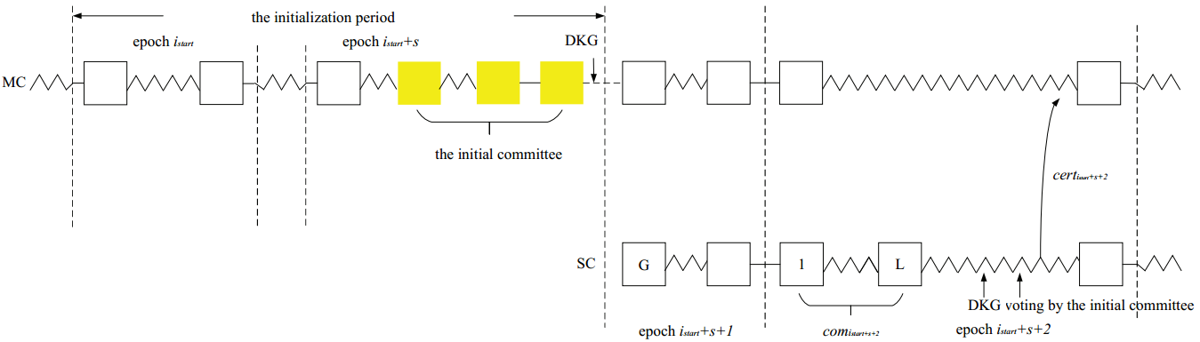
Introduction
Ge-Co [2]: Sidechains with optimally succinct proof
Epoch index
Merkle-tree commitment
Public key
TSS signature
Cross-chain certificate
Committee votes to form a threshold signature
[2] L. Yin, J. Xu, K. Liang, and Z. Zhang, “Sidechains with optimally succinct proof,” IEEE Transactions on Dependable and Secure Computing, vol. 21, no. 4, pp. 3375–3389, 2024.
Notes:
Next, we
The Ge-Co certificate only contains the epoch index, the Merkle-tree commitment to pending transactions, the latest main public key and a TSS signature.
Thus Ge-Co achieves an optimally succinct and constant proof size

Slide 5
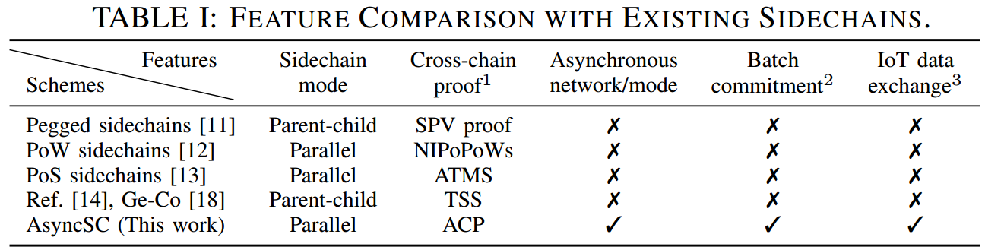
Introduction
Existing work lacks research on cross-chain under an asynchronous mode
Each cross-chain proof only commits on a single transaction usually, which limits the cross-chain efficiency
It is hard to meet the requirement of large-scale data exchange in multi-domain IoT environment
Notes:
Further more, we conclude the SOTA sidechains in this table
Three main Problems：
Existing work lacks research on cross-chain under an asynchronous mode.
The cross-chain proof only commits on a single transaction usually, which limits the cross-chain efficiency.
Finally, it’s hard to meet the requirement of large-scale data exchange in multi-domain IoT environment

Slide 6
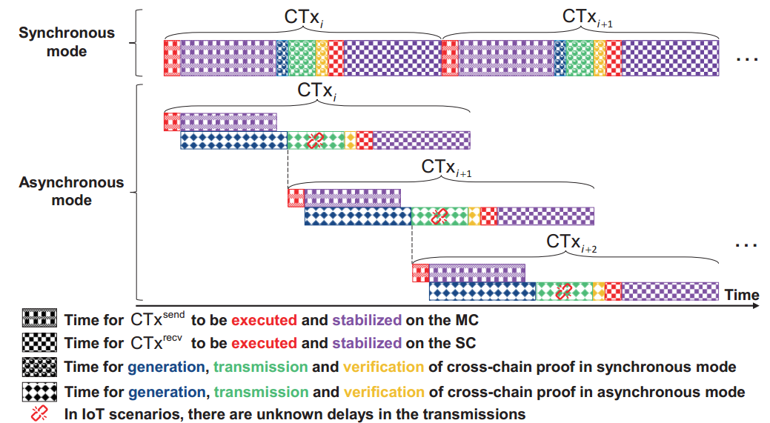
Motivation
Challenges and our Solutions
Synchronous cross-chain interaction mode is inefficient
A novel cross-chain interaction model for asynchronous sidechains
Traditional cross-chain proofs are not applicable in asynchronous mode
A cross-chain cryptographic primitive based on delayed aggregate signatures
Asynchronous cross-chain transaction sequence consistency problem
Asynchronous cross-chain consistency mechanism with sequential protection
Notes:
Now let’s move on to the core motivation behind our work. As we can see from the right figure
Under synchronous networks, cross-chain proofs are assumed to be transmitted from MC to SC within a finite time, and the timing required for each CTx does not overlap. However, in this paper’s context, message transmission between MC and SC may be interrupted, causing CTxs in synchronous mode to be blocked. To ensure proper business operations, we propose allowing the timings of CTxs to partially overlap in asynchronous mode.
We observe three major challenges in existing

Slide 7
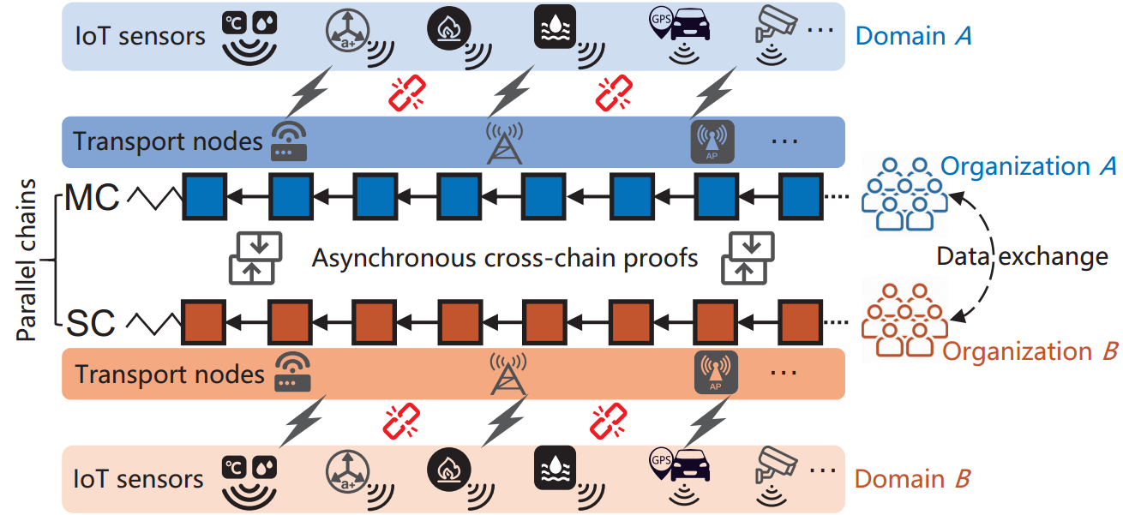
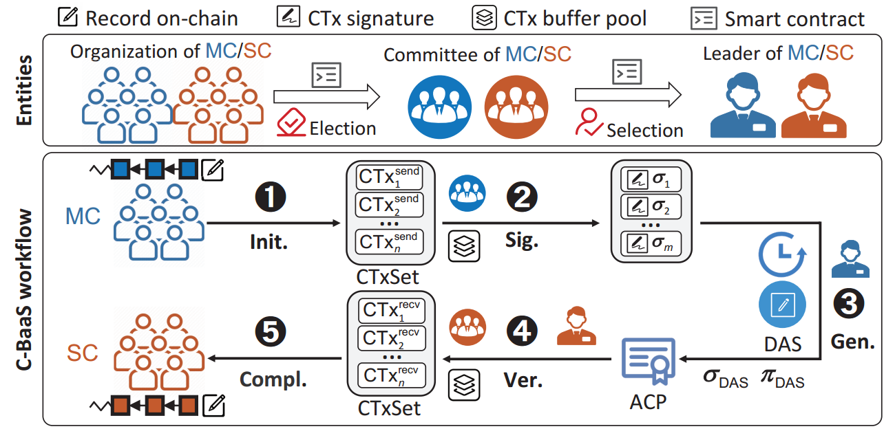
System Model and Workflow
System model of AsyncSC
Entities and workflow in AsyncSC
Example. Multi-domain data exchange scenarios in IoT.
Core idea. Cross-chain communication is achieved by generating and verifying ACPs.
ACP generation. The MC’s leader generates an ACP commit on a batch of CTxs within an epoch.
ACP verification. The SC’s leader verifies the validity of the ACP.
CTxs check. SC committee conducts a transaction sequentiality check utilizing the buffer pool maintained by MC to prevent conflicts.
Notes:
Next, I will introduce our system model。
Multi-domain devices data、different organizations、committee
（example in IoT scenario）Due to resource constraints of IoT devices and unstable network connections, cross-chain communication is achieved by generating and verifying asynchronous cross-chain proofs (ACPs)

Slide 8
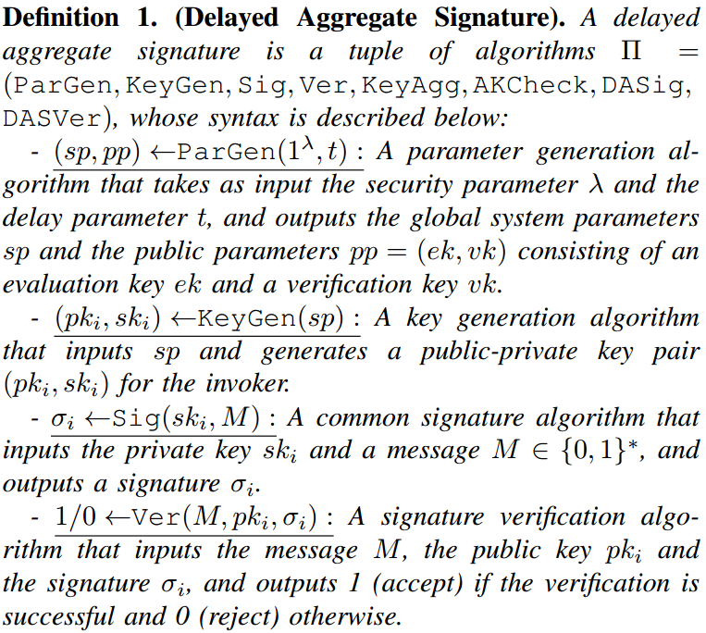
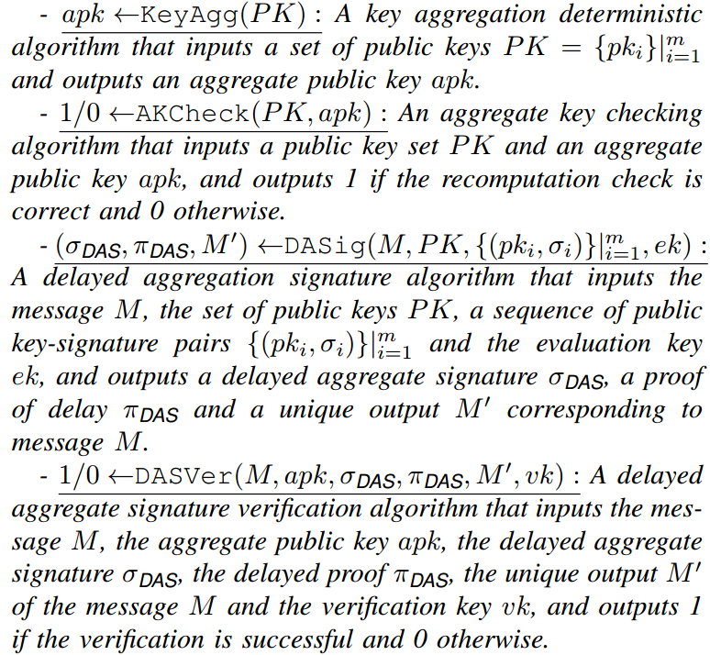
ACP: DAS definition
Notes:
Next, we present the design details of our proposed system. First, the core of an ACP is the DAS (delayed aggregate signature)
The DAS scheme consists of a set of sub-algorithms
Including the 。。。

Slide 9
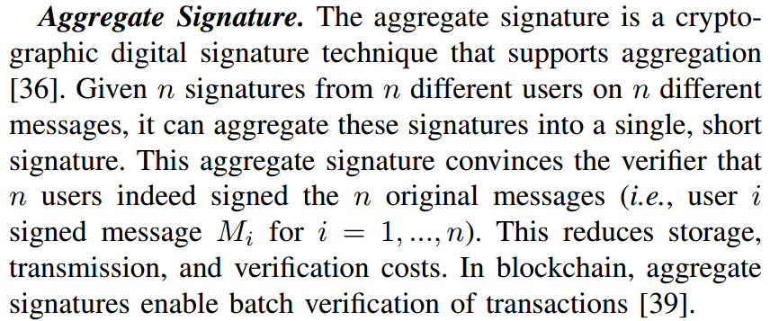
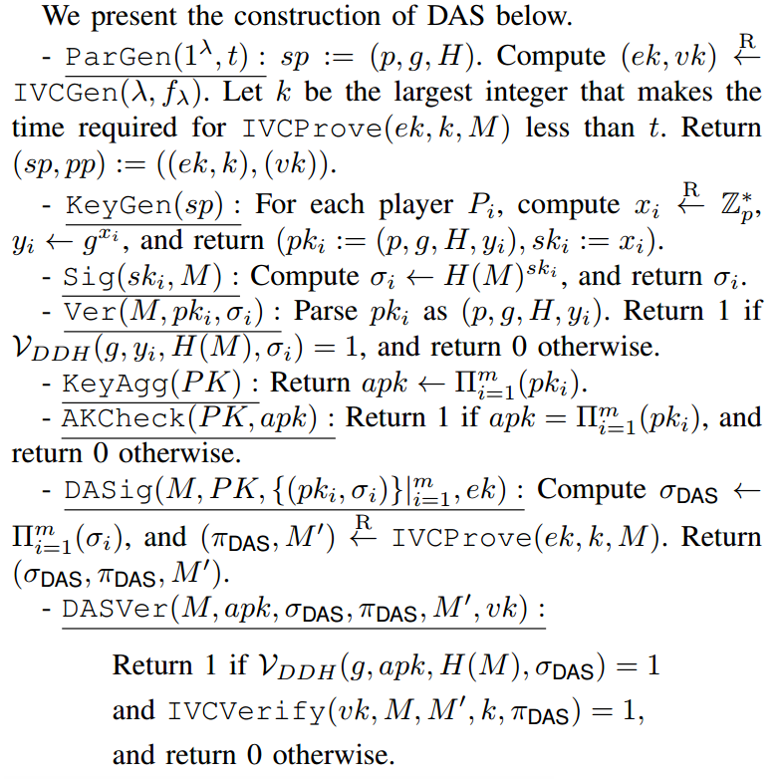
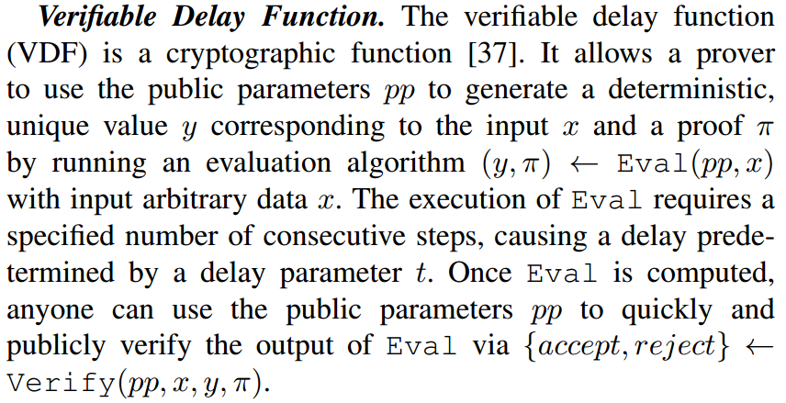
ACP: DAS construction
Notes:
The specific realization of DAS is partially inspired by two primitives: aggregate signatures and VDFs. In a short, the …
We extract the signature compression property of aggregate signatures and the delay verifiability property of VDFs to implement compact ACPs.
We refer to the detailed constructions in the multi-signature scheme MGS （based on Decisional Diffie-Hellman (DDH) problem ） [43] and the VDF scheme for incremental verifiable computation (IVC) [37] to realize the DAS scheme
For IVC, we can construct an IVC proof system via any succinct noninteractive argument of knowledge (SNARK) system

Slide 10
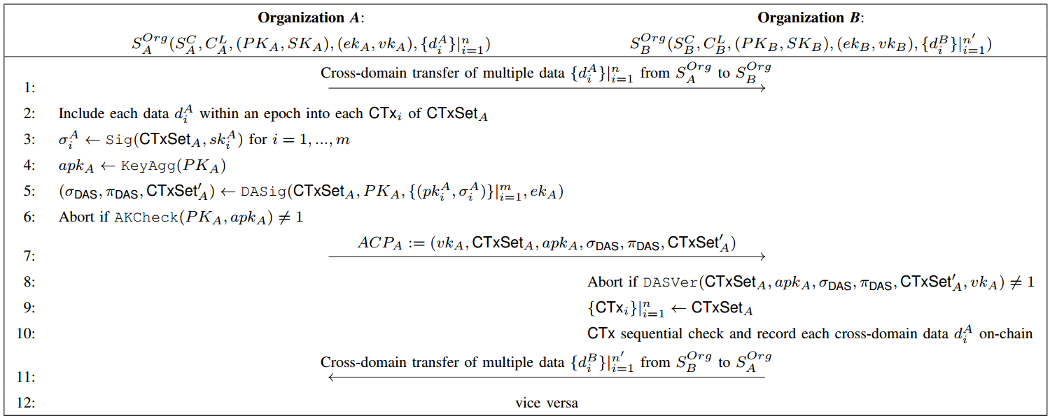
ACP: Apply DAS to AsyncSC
Notes:
This picture shows the Procedure of applying DAS to AsyncSC，and it’s the core of cross-blockchain as a service (which is called C-BaaS in this paper)
We take two organizations A and B as an example，

Slide 11
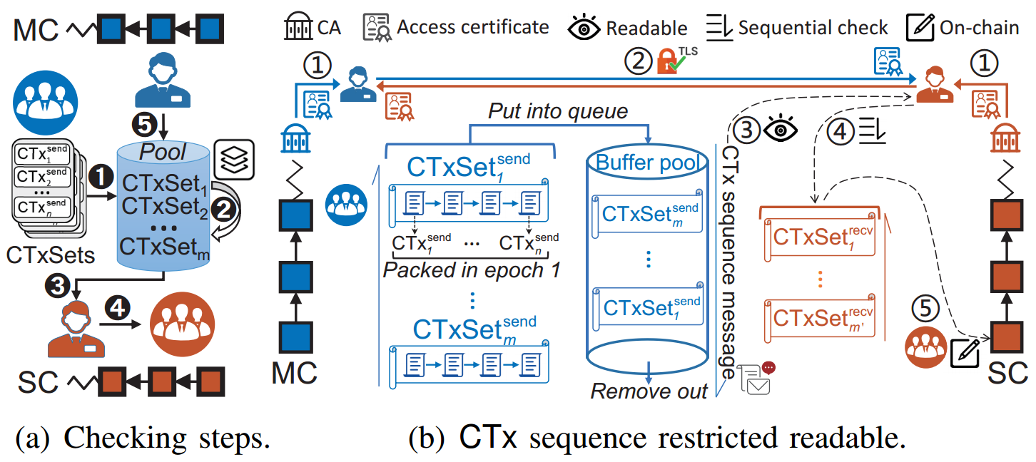
CTx sequence guarantee mechanism
Notes:
Asynchronous transaction sequence guarantee mechanism.
In an asynchronous network, MC’s cross-chain proofs may be transmitted to SC after unknown delays due to unstable communications. Thus, SC needs to ensure that the order of asynchronous transactions is consistent with MC
To avoid this issue, we address the consistency problem of asynchronous CTxs by maintaining transaction buffer pools via committees and devising an asynchronous transaction sequence guarantee mechanism
The sequential check consists of five main steps, as shown in Fig.
Receiving. When the MC’s committee receives the CTxSet for each epoch, its leader maintains these CTxs in the local multilevel buffer pool. The multilevel buffer pool uses an adaptive heap structure to categorize and store transactions according to different priorities (e.g., timestamp, importance, dependency). The adaptive heap dynamically adjusts the order based on the current load situation and the dependencies of the CTxs, ensuring that CTxs with high priority and early timestamps are located at the top of the heap.
Ordering. The MC leader dynamically adjusts the order of the pooled CTxs to optimize processing efficiency, using a sliding window approach in micro-batch processing. It also dynamically adjusts the window size and movement speed based on real-time transaction traffic.
Processing. The leader of SC performs conflict checking on the CTxs in each CTxSet received asynchronously based on the buffer pool maintained by MC, and then sends the processed set of CTxs to the committee for confirmation.
Confirming. The committee of SC uses smart contracts to automate the confirmation of the transaction order and ensure consistency through BFT consensus algorithms such as Tendermint. After confirming that there are no conflicts, the relevant CTxs are executed in an orderly manner.
Removing. Finally, after confirming that the CTxs have stabilized through a persistent query on the ledger, the leader of MC removes the executed CTxs from the buffer pool.
As for the Restricted Readable Mechanism: In the context of this paper, to adhere to the internal confidentiality of permissioned blockchains, the CTx sequence maintained by the buffer pool is restricted to be readable only by authenticated leaders

Slide 12
Evaluation
Implementation
AsyncSC: We implement a prototype based on two well-known permissioned blockchains: Hyperledger Fabric and ChainMaker, using the Go language.
Baselines:
(i) Strawman. An incomplete AsyncSC prototype using SPV proof for each CTx as a commitment.
(ii) Ge-Co. A sidechain scheme that uses committee voting for threshold signatures.
(iii) ChainMaker. Uses cross-chain proxy, SPV, and transaction contracts, supporting cross-chain operations with Fabric.
(iv) WeCross. Relay-based cross-chain routing that enables data interoperability between Fabric and FISCO BCOS.
(v) BitXHub. Provides an InterBlockchain Transfer Protocol (IBTP) based on relay chains for reliable routing between permissioned blockchains
Notes:
we implement a prototype based on two well-known permissioned blockchains: Hyperledger Fabric and ChainMaker, using the Go language

Slide 13
Evaluation
Settings
Testbed: It consists of 16 virtual machines, each equipped with an Intel i7-13700 CPU, 8 GB of RAM, and a 5 Mbps network link.
Dataset: We use the real-world IoT dataset TON_IoT, which contains over two million pieces of raw telemetry data collected by weather and Modbus sensors . Blockchains from different organizations first store different data and then exchange a number of data per epoch.
Metrics:
(i) Throughput. The number of successful executions of CTx per second by the system (TPS).
(ii) Latency. The duration for a CTx to stabilize on SC from the time it is initiated by MC.
(iii) Success ratio. The percentage of successful executions in initiated CTxs (TSR).
(iv) CPU and memory utilization. The resource consumption of the system during execution.
Notes:
To simulate semi-synchronous/asynchronous communication, we use a kind of tc command on each machine to control transmission delay ∆ (100 ∼ 500 ms) and network jitter (± 25 ms), and to generate CTx timeouts (i.e., ∆ > ∆async) with a changing ratio

Slide 14
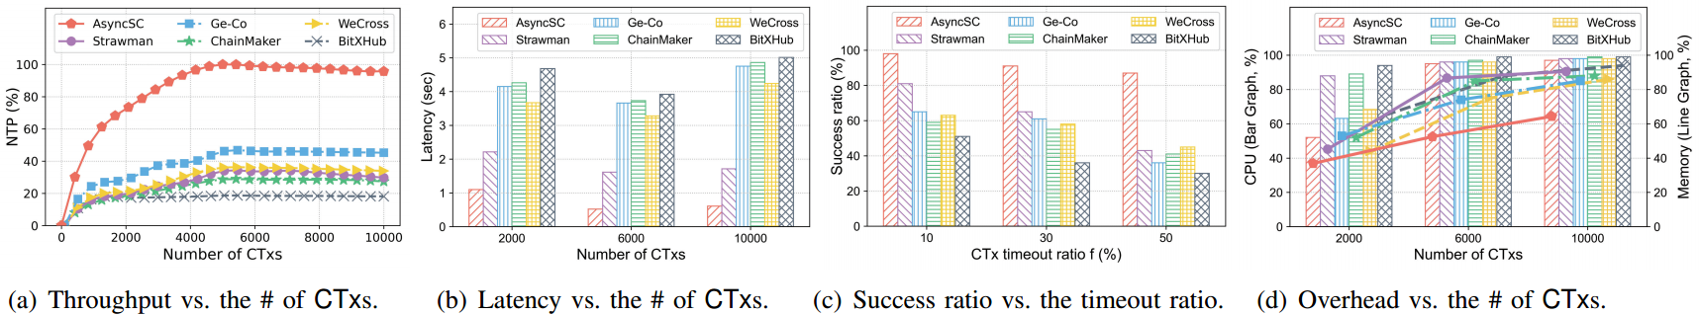
Evaluation
Performance comparison of different baselines across various metrics
AsyncSC shows an average increase in throughput of 1.21 ∼ 3.96 ×
AsyncSC reduces the latency by 59.76% to 83.61%
AsyncSC increases the CTx success ratio by 46.03% to 135.9%
AsyncSC reduces the overall CPU and memory utilization by an average of 5.1% to 16.44% and 25.02% to 37.77%, respectively

Slide 15
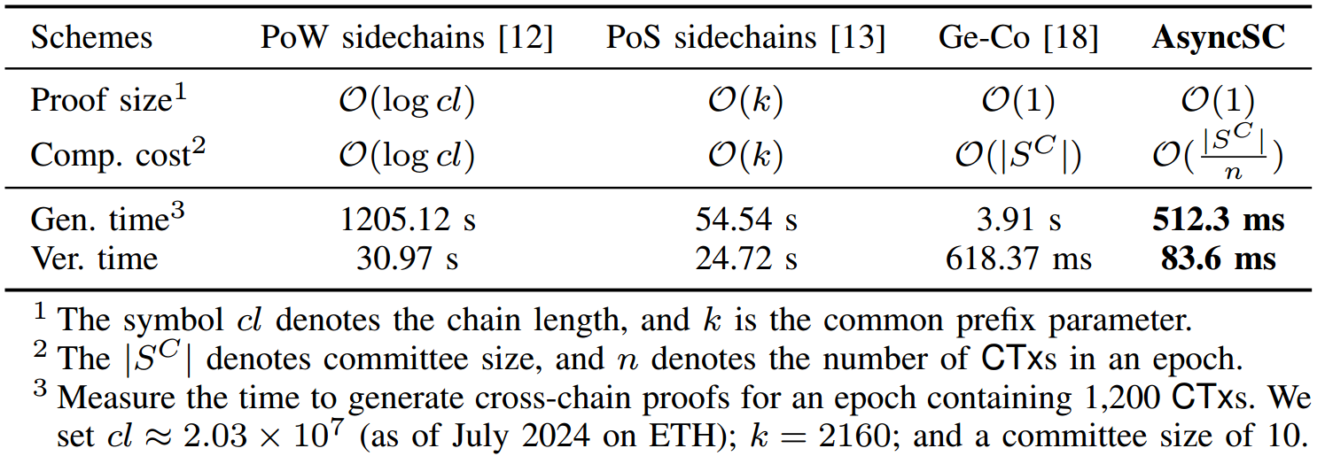
Evaluation
Comparison of cross-chain proofs
AsyncSC reduces the proof generation and verification times by 1 to 4 and 1 to 3 orders of magnitude, respectively, compared to SOTA schemes

Slide 16
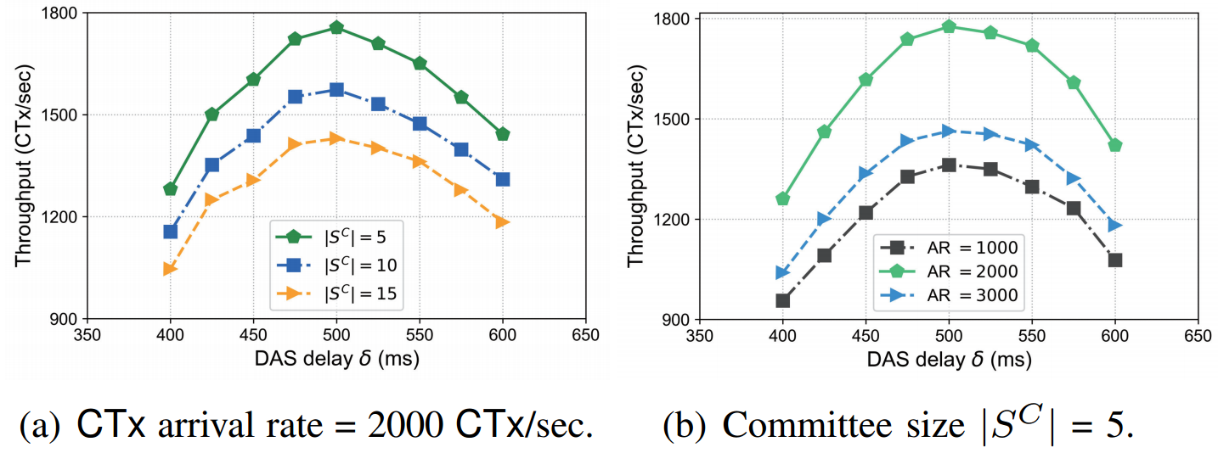
Evaluation
Evaluating system throughput vs. DAS delay
The throughput first increases and then decreases with the increase of δ
Too few or too many CTxs being processed at each epoch, potentially causing the system to be underloaded or overloaded, thereby affecting system throughput
Notes:
每个epoch处理的CTx数量过少或过多，可能导致系统负载过低或过载

Slide 17
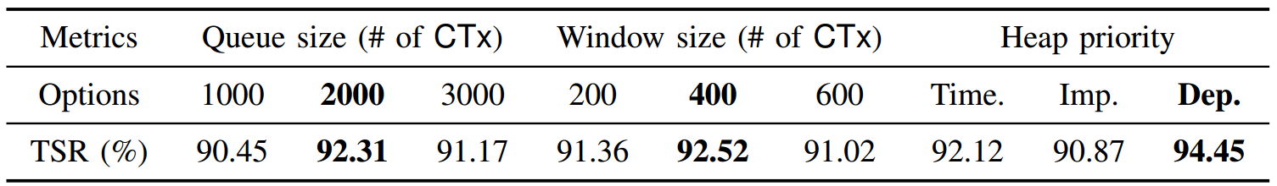
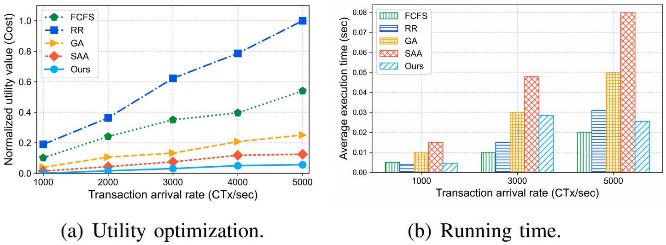
Evaluation
Evaluation of CTx buffer pool
Evaluating different options for CTx buffer pools
Moderately increasing the queue size can improve TSR, but an excessively large queue may reduce processing efficiency
A larger window helps improve TSR, but an excessively large window may increase the probability of conflicts
The dependency prioritization strategy improves TSR more than timestamp and importance prioritization
Our heuristic algorithms demonstrate significant utility gains over existing classical algorithms
Comparison of various algorithms for buffer pool optimization
Notes:
The dependency prioritization strategy improves TSR more than timestamp and importance prioritization, indicating that considering inter-transaction dependencies in multilevel buffer pools is effective.
Heuristic algorithms demonstrate significant utility gains over existing classical algorithms

Slide 18
Conclusion
An asynchronous cross-chain mode.
Cross-chain security is ensured by lightweight asynchronous cryptographic proofs;
Committee cyclically provides C-BaaS to enable efficient data interactions across multi-domains.
Innovative cryptographic proofs.
We introduce a novel cryptographic primitive called delayed aggregate signature (DAS) to generate asynchronous cross-chain proofs (ACPs) underpinning IoT multi-domain data exchanges.
Restricted-readable consistency mechanism.
CTx sequence guarantee mechanism ensures the consistency of asynchronous cross-chain transactions.
Evaluation.
We built a prototype based on Hyperledger Fabric and ChainMaker. It improves throughput by an average of 1.21 ∼ 3.96 ×, reduces latency by 59.76% to 83.61%, enhances success ratio by a relative 46.03% to 135.9%, and maintains comparable overhead.

Slide 19
Thanks
NSS Lab @ XDU
https://nss.xidian.edu.cn/
Email: xwdong@xidian.edu.cn

